Slide 1
Crime Data Analysis – 2020
Dataset: Individual_Incident_2020.csv
Presented By: Alamaara Kazi

Slide 2
CONTENT
Introduction
Problem Statement
Methodology
Results
Analysis & Insights
Dashboard Overview

Slide 3
INTRODUCTION
The file Individual_Incident_2020.csv has crime incident data for the year 2020.
It contains 53 columns such as state, incident_number, total_offense and total_victim.
The dataset includes different offense types like theft_offense, violence_offense and drug_offense.
It also has details about gun_involvement, property_value and victim information.

Slide 4
Problem statement
To load and clean the Individual_Incident_2020.csv dataset.
The dataset contains 53 columns with different data types such as string and float.
The dataset contains 53 columns with different data types such as string and float.
The file size and processing caused issues while exporting the cleaned dataset.

Slide 5
Methodology
Data cleaning and analysis was done using Anaconda Navigator (Jupyter Notebook).
• To view the data columns and create pivot charts, MS-Excel was used.
• Interactive dashboard was created using Power BI Desktop.
• SQL queries were executed in MySQL Workbench.

Slide 6
Results
The data clearly shows that non-gun crimes are much higher than gun-related crimes in 2020.

Slide 7
The data shows that theft_offense is much higher than all other offense types.

Slide 8
This means crime impact is not equal across all states.

Slide 9
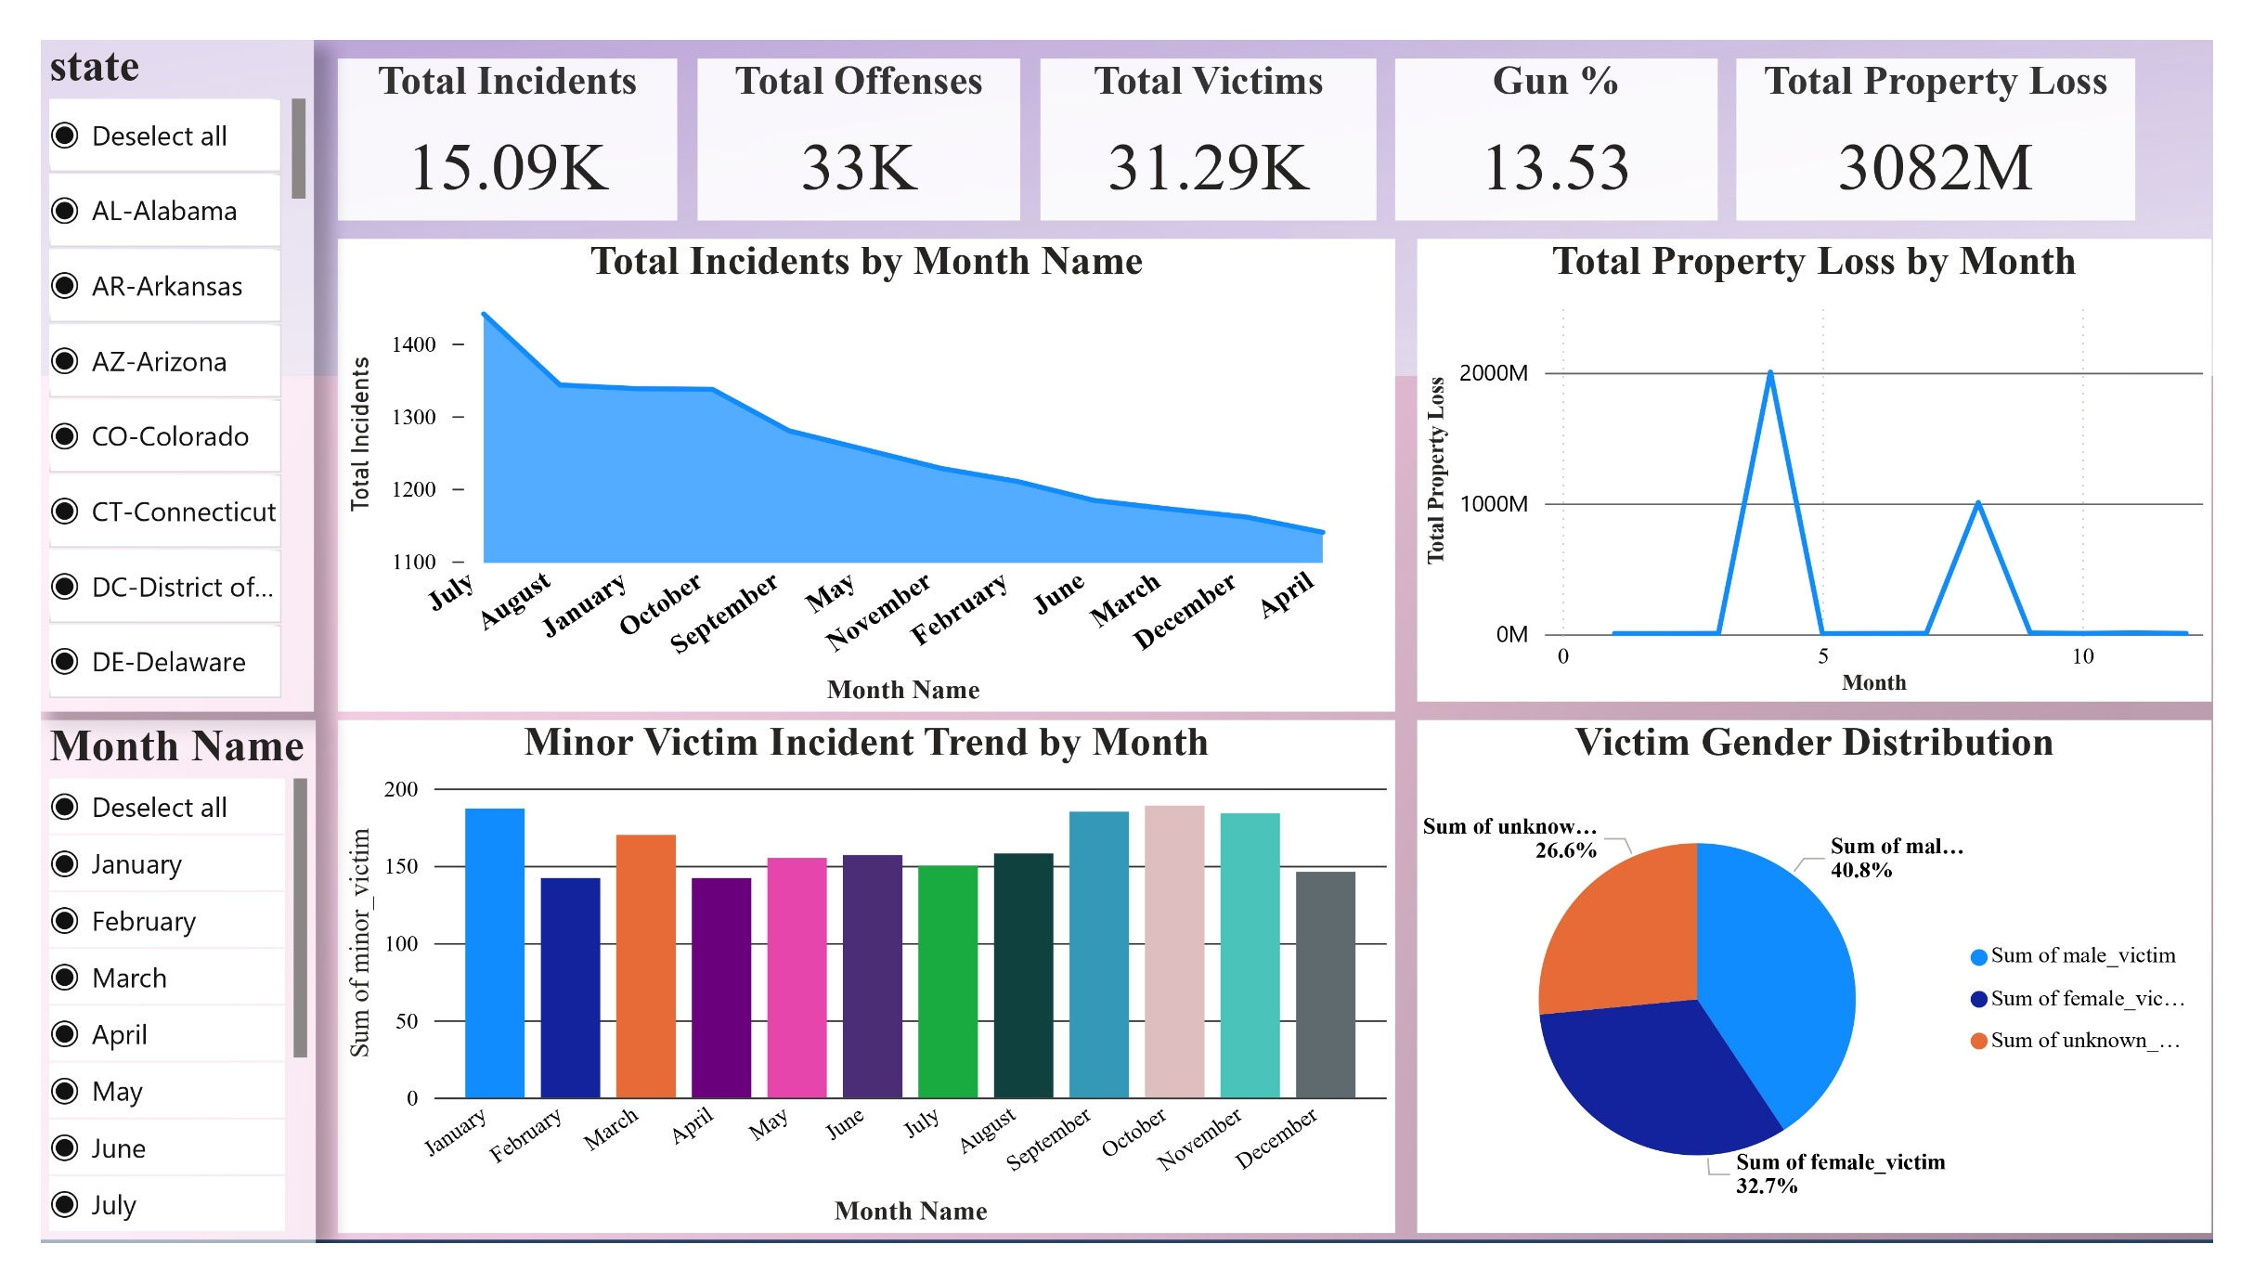
This Power bi dashboard shows a complete view of crime data by showing total incidents, victims, gun involvement, property loss, and monthly patterns.

Slide 10
Analysis and Insight
Which victim group is mostly affected?
→ male_victim count is higher than female_victim and unknown_sex_victim.
What is the percentage of gun_involvement?
→ Around 12–13% of total incidents involve gun_involvement.
Which states have more total_victim cases?
→ States like Texas and Washington show higher total_victim numbers.
Is property_value loss significant?
→ property_value shows high loss in some months, especially mid-year.
Are all offenders known?
A: No. Many cases are marked as offender_not_known.

Slide 11
Thank you
Alamaara Kazi
+91 9860939091
https://github.com/alamaara1725
alamaara.ds25@gmail.com

